Slide 1

PI BI PROJECT
4 ERP BI 6

Slide 2
Members :
Oussama
Nouri
Dorsaf
Tlili
Achref
Zeddini
Ons
Bouali
Aymen
Touihri

Slide 3
Plan :
Project
context
Problem
And
Solution
Project
presentation
methodology
Data
warehouse
Application
Web
Tools

Slide 4
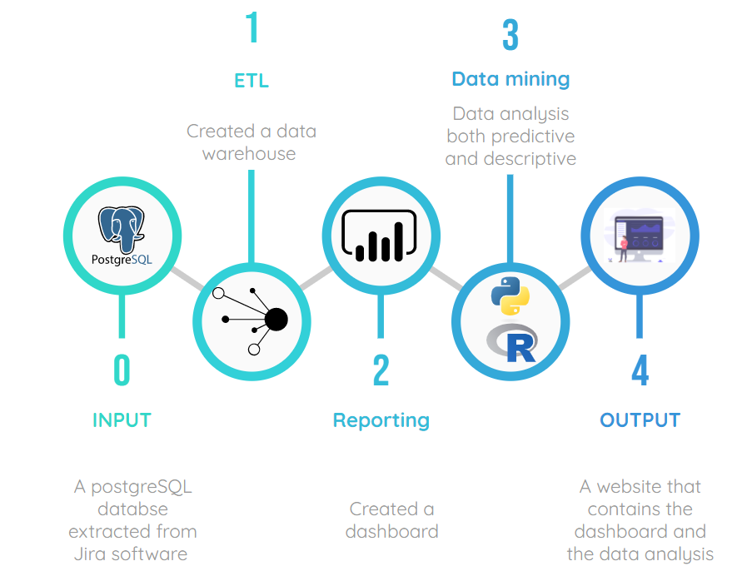
I
Project Presentation

Slide 5


II
Project context
1. Talys :
2. Jira

Slide 6
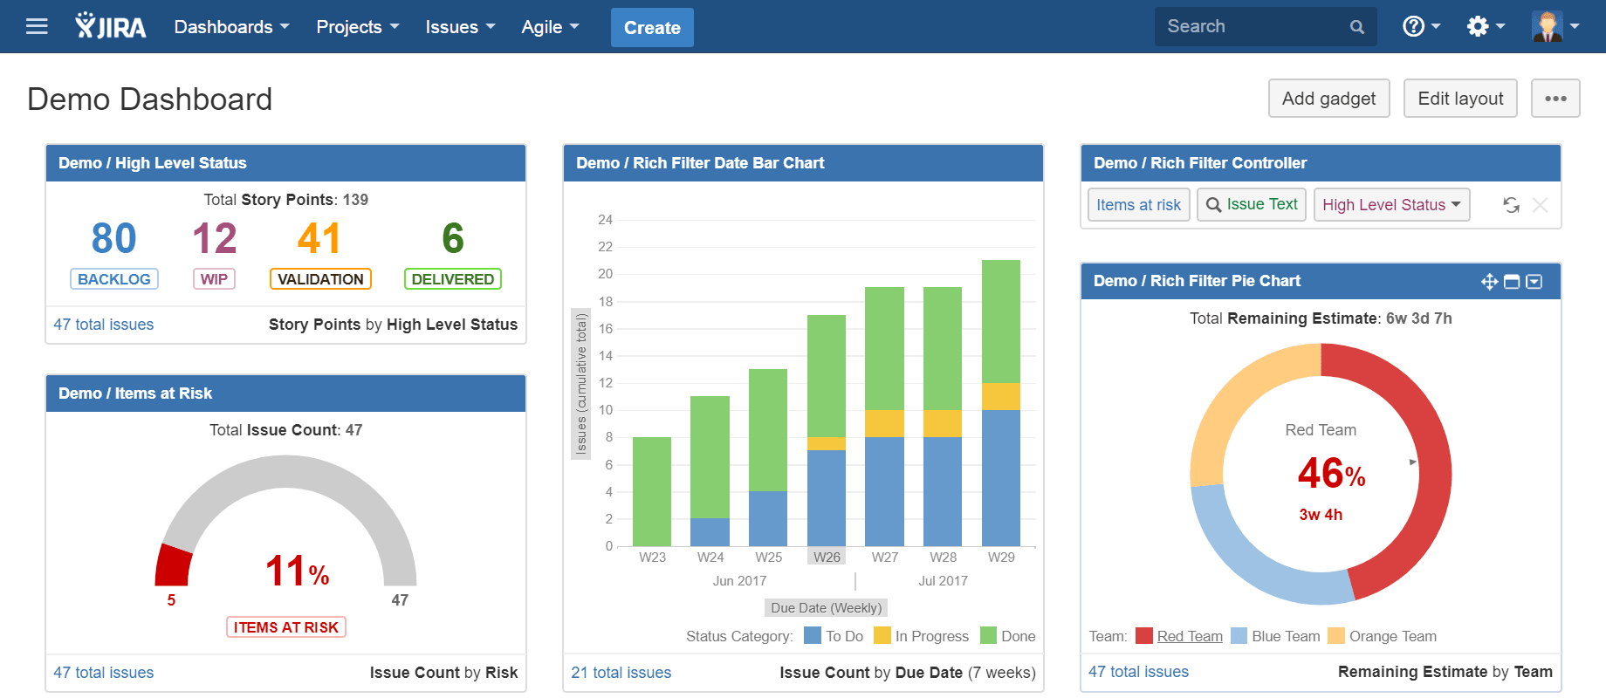
Problem: Limitation of the existing solution
III

Slide 7

IV
Solution
Feature-Benefit charts

Slide 8
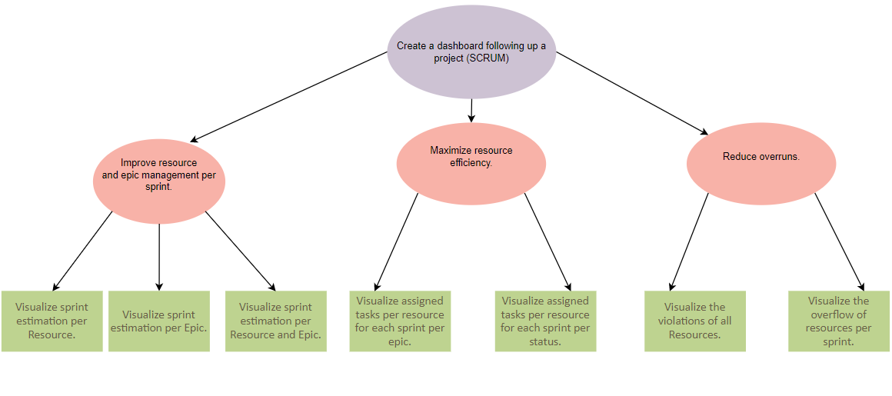
V
Objectives Tree
Improve time management and efficiency

Slide 9
VI
Methodology
GIMSI

Slide 10
01
Generalization
G
02
GIMSI
I
Information
Defines a methodological framework in order to better formalize the conditions of BI project successes centered on the “dashboard” issue
03
M
Methods and Measurement
I
S
05
04
Individuality and Initiative
System and Systemic

Slide 11
GIMSI
Identification
Conception
Implementation
Improvement
01
02
03
04

Slide 12
1. Identification
BUSINESS
ENVIRONNEMENT
IDENTIFICATION OF
THE ENTREPRISE

Slide 13
2. Conception
DEFINITION OF
THE OBJECTIVES
COLLECTING
INFORMATIONS
THE CHOICE OF
INDICATORS
THE CONSTRUCTION
OF THE DASHBOARD
THE DASHBOARD
SYSTEM

Slide 14
3. Implementation
THE CHOICE OF SOFTWARE
INTEGRATION AND DEPLOYMENT

Slide 15
4. Improvement
AUDIT

Slide 16







VII
Tools

Slide 17
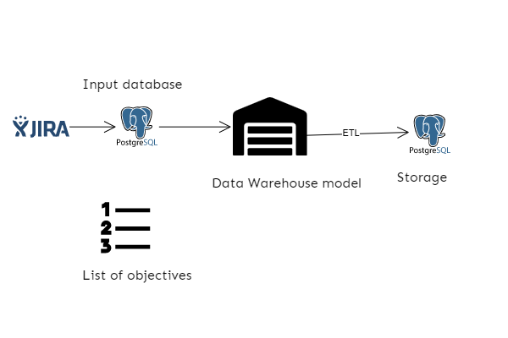
VIII
Data Warehouse

Slide 18
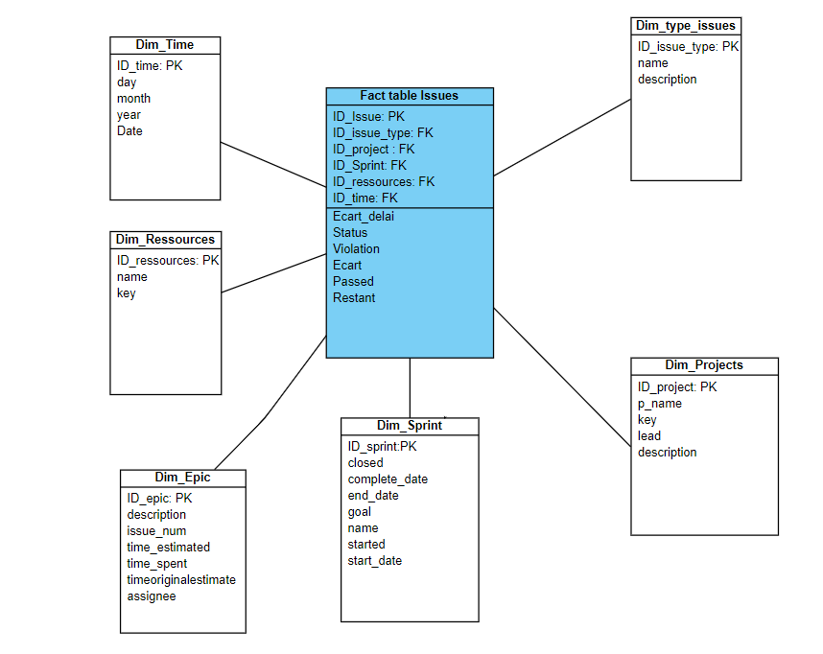

Slide 19
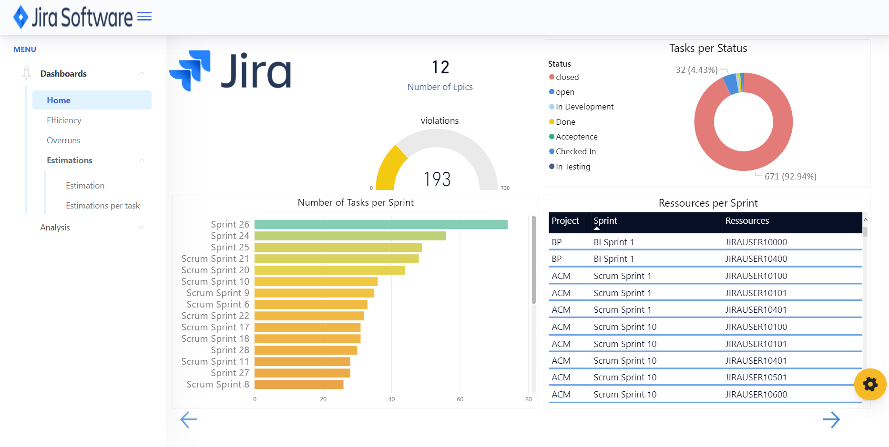
IX
Web Application

Slide 20
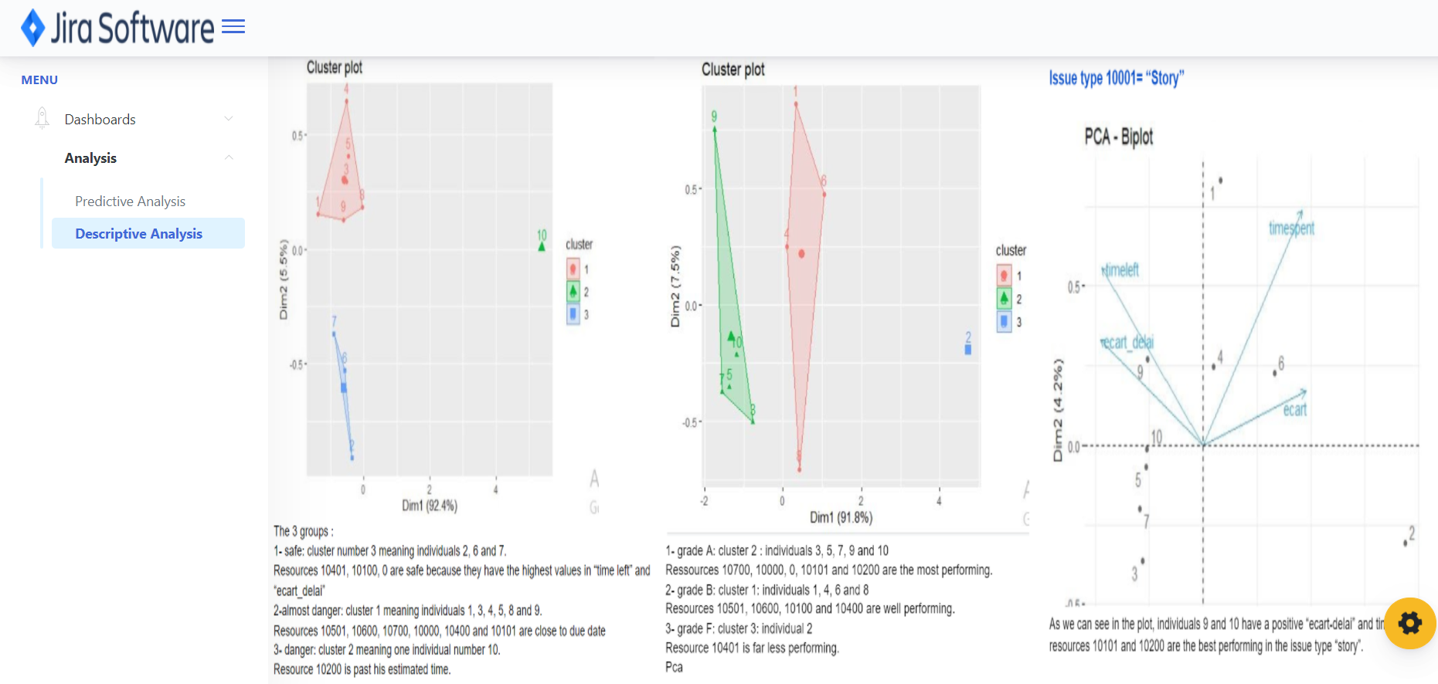

Slide 21
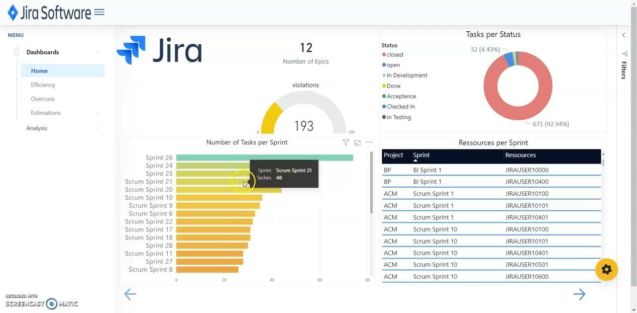

Slide 22
Conclusion
X
A clear and organized dashboard .
DASHBOARD
A clear documentation of how to use the dashboard.
The outcome of this project is a COMPLETE and ORGANIZED dashboard that meets the need of the client.
Organized view of data.
Easily manipulated layout.

Slide 23

THANK YOU

